Slide 1
Session 6 ANALYSIS OF VARIANCE INTRODUCTION

Slide 2
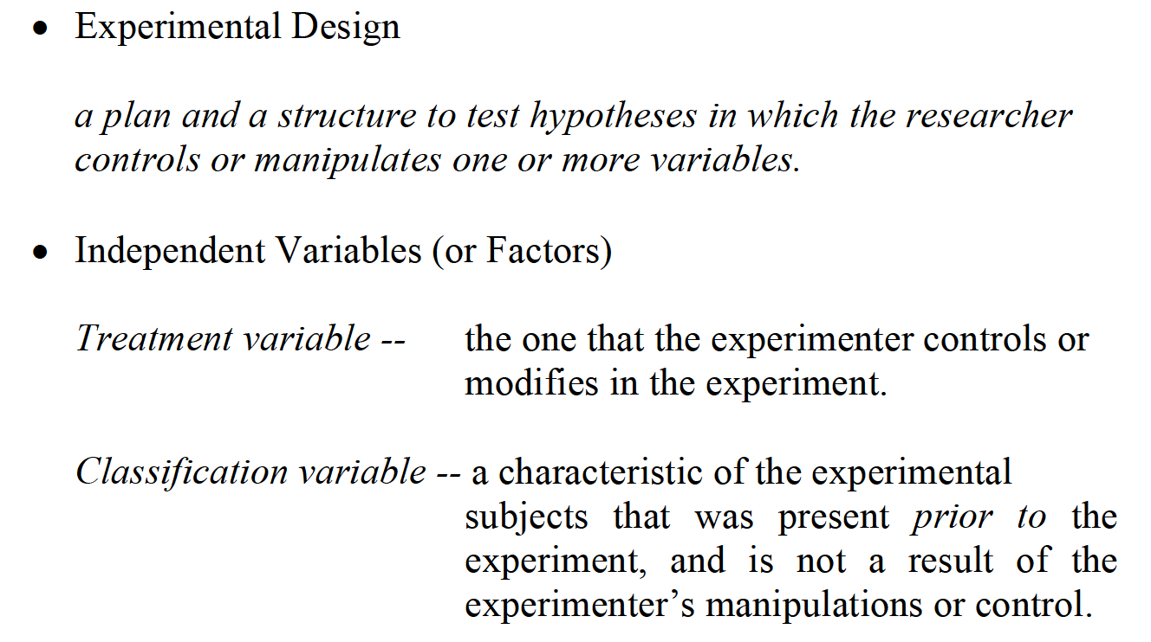
BASIC CONCEPTS

Slide 3
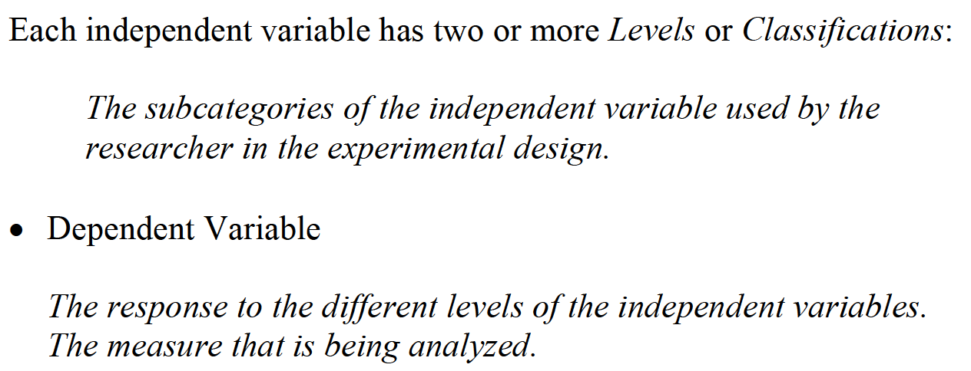
BASIC CONCEPTS

Slide 4
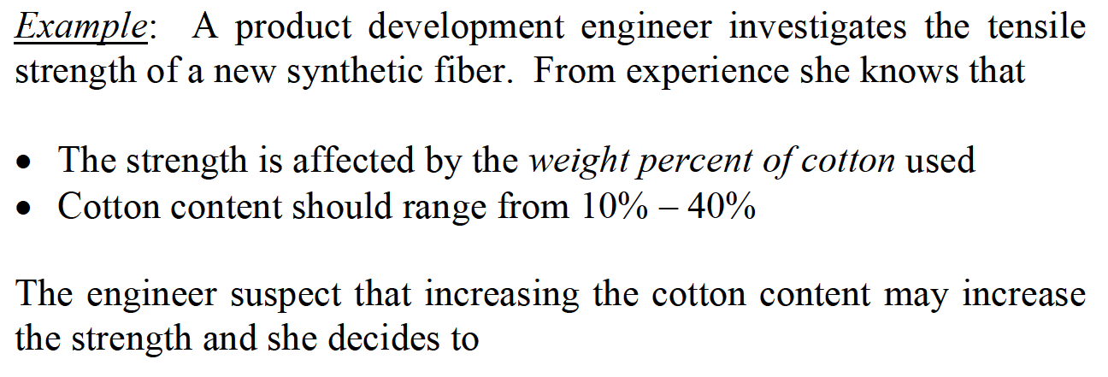
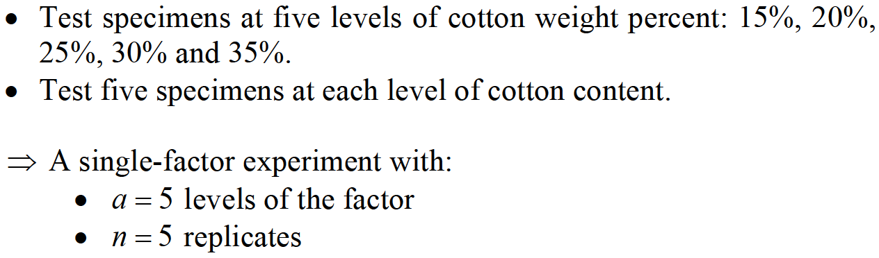
BASIC CONCEPTS

Slide 5
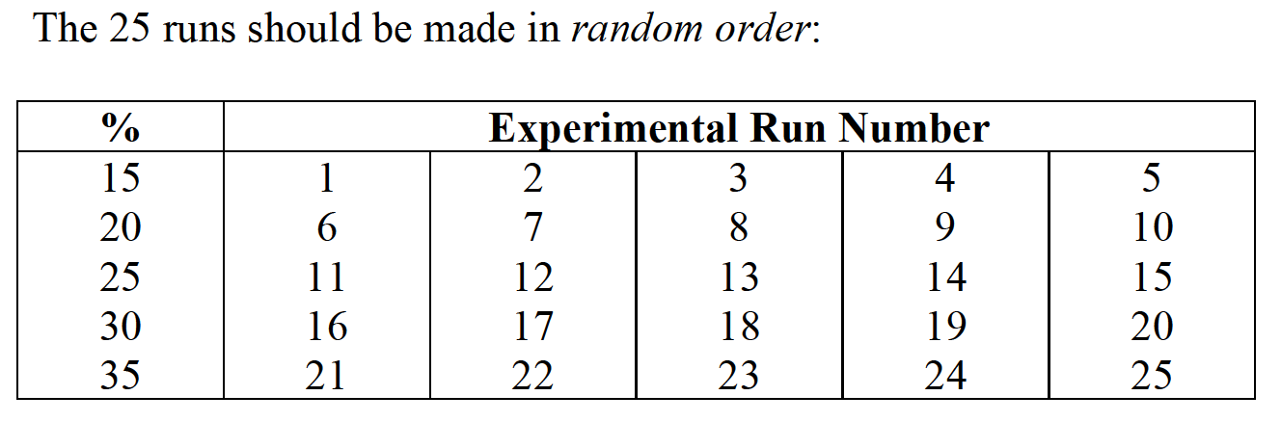
BASIC CONCEPTS

Slide 6
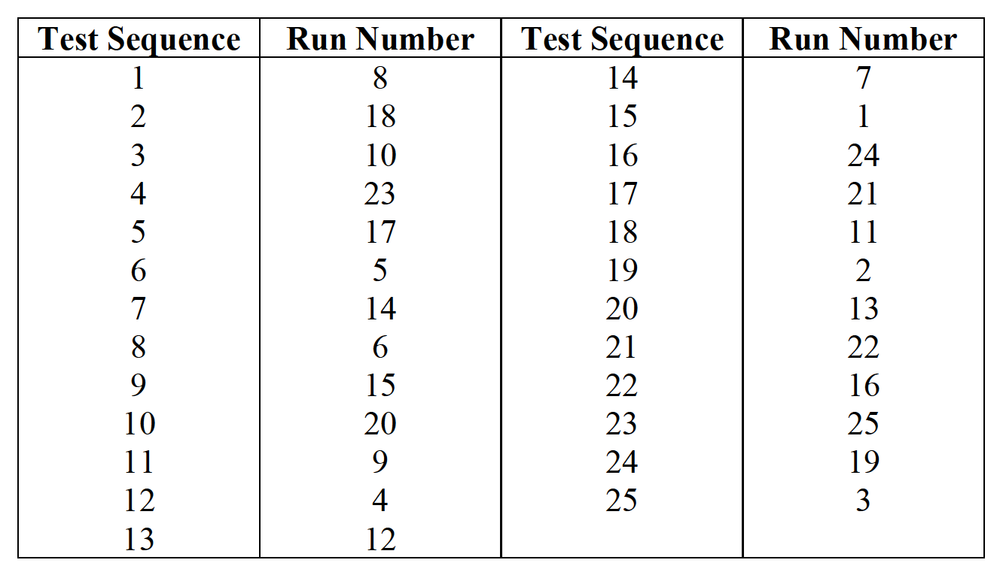
BASIC CONCEPTS

Slide 7
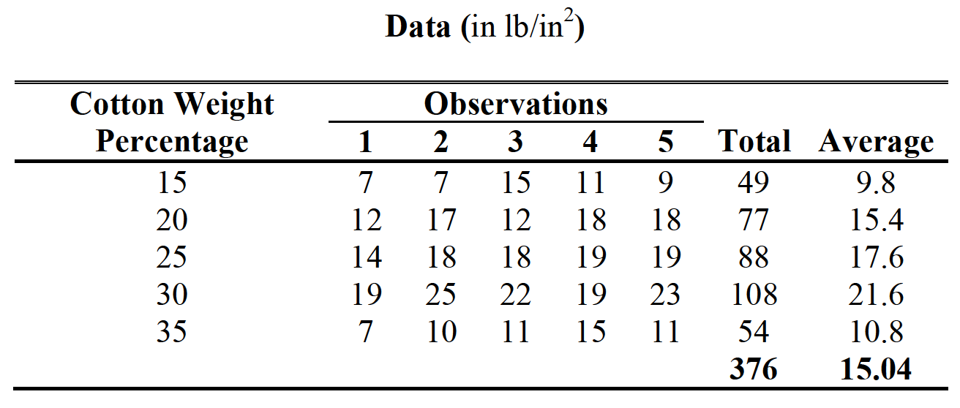
BASIC CONCEPTS

Slide 8

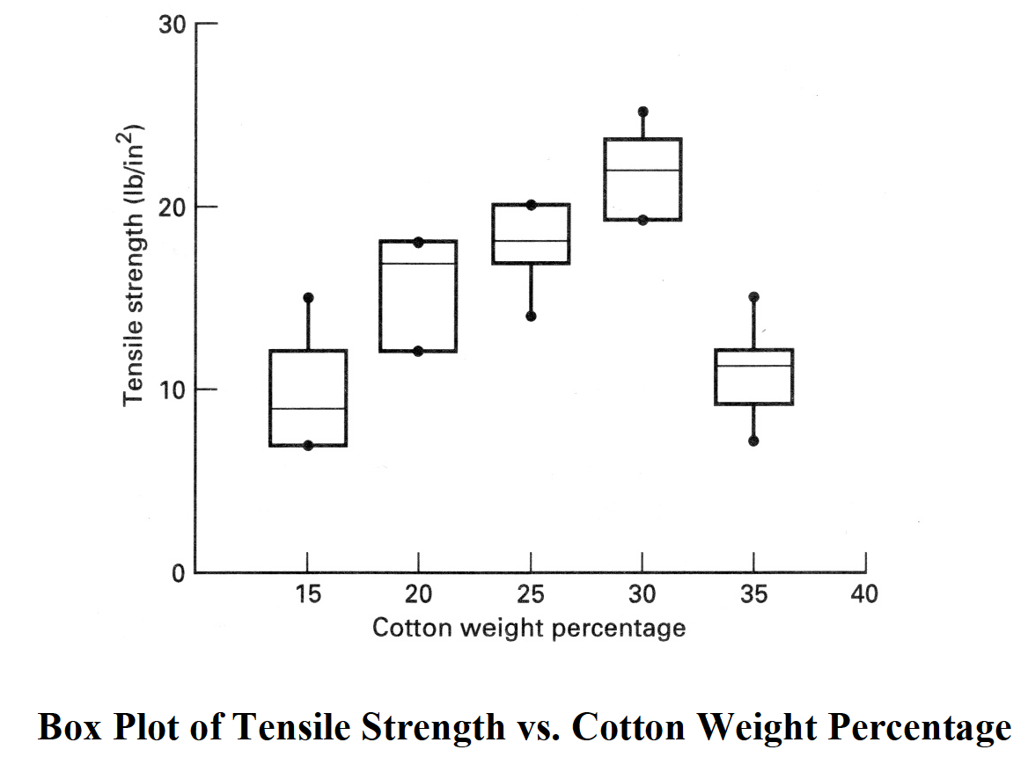
BASIC CONCEPTS

Slide 9
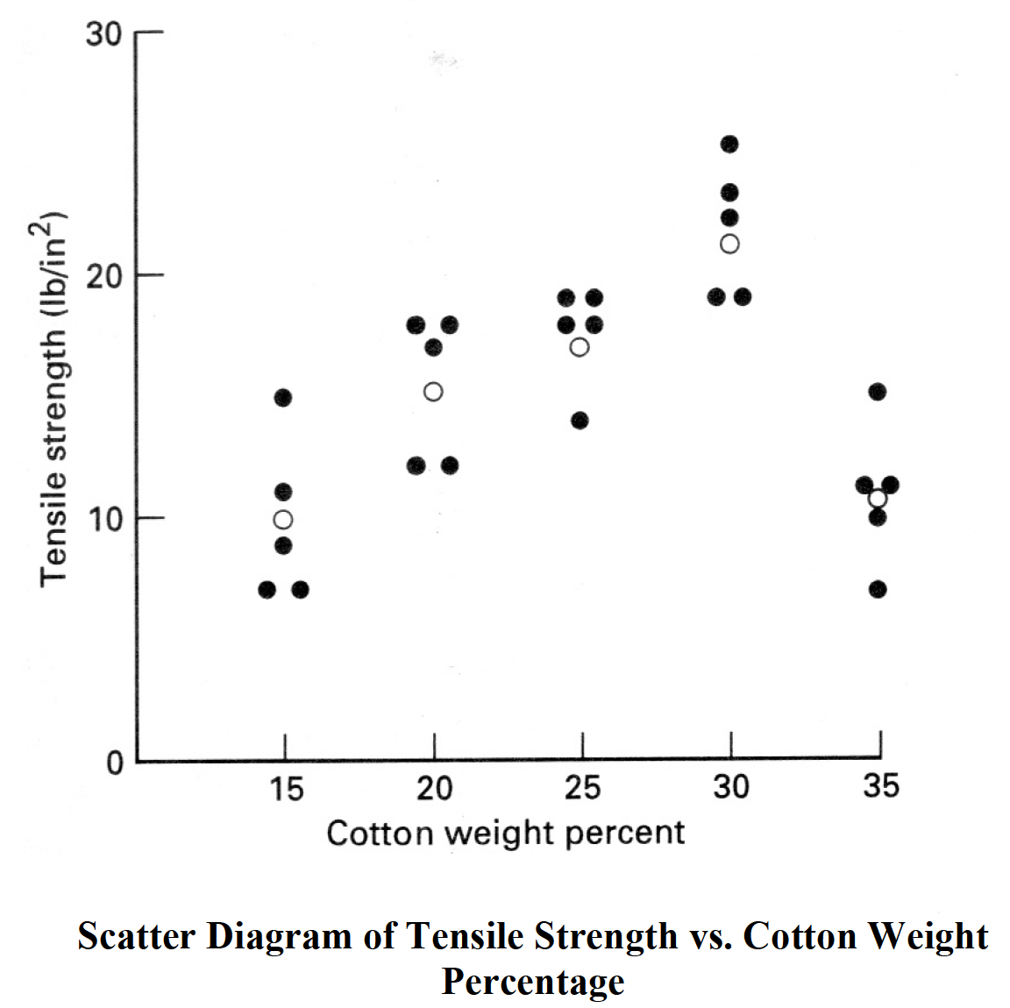
BASIC CONCEPTS

Slide 10
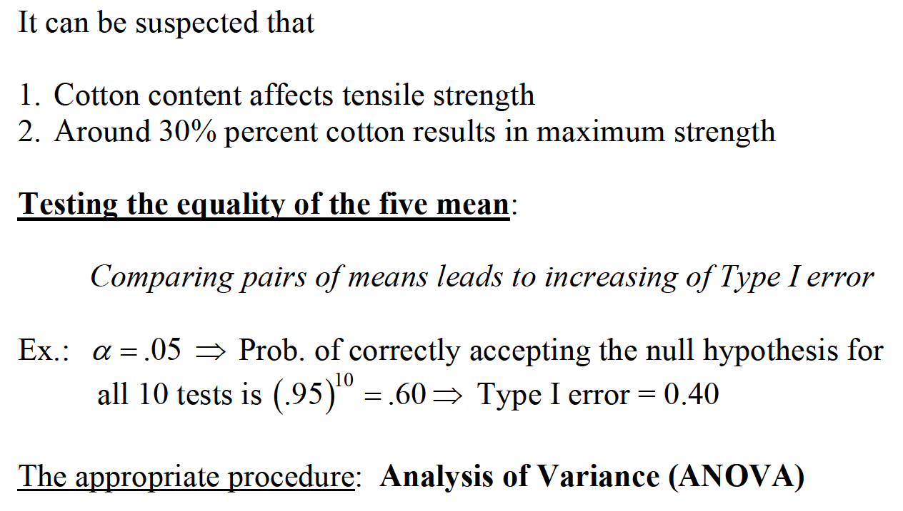
BASIC CONCEPTS

